Slide 1
David M. Kroenke and David J. Auer
Database Processing:
Fundamentals, Design, and Implementation
Chapter Two:
Introduction to Structured Query Language

Slide 2
Chapter Objectives I
Structured Query Language (SQL)
SELECT/FROM/WHERE framework
retrieve data from
  a single table
To be able to write queries in SQL to use SQL DISTINCT, AND, OR, NOT, BETWEEN, LIKE, and IN keywords

Slide 3
Structured Query Language
Structured Query Language (SQL) was developed by the IBM Corporation in the late 1970’s.
SQL was endorsed as a U.S. national standard by the American National Standards Institute (ANSI) in 1992 [SQL-92].

Slide 4
SQL As a Data Sublanguage
SQL is not a full featured programming language.
  C, C#, Java
SQL is a data sublanguage for creating and processing database data and metadata.
SQL is ubiquitous in enterprise-class DBMS products.
SQL programming is a critical skill.

Slide 5
SQL DDL and DML
SQL statements can be divided into two categories:
  Data definition language (DDL) statements
    Used for creating tables, relationships, and other structures
    Covered in Chapter Seven
  Data manipulation language (DML) statements
    Used for queries and data modification
    Covered in this chapter (Chapter Two)

Slide 6
Cape Codd Outdoor Sports
Cape Codd Outdoor Sports is a fictitious company based on an actual outdoor retail equipment vendor.
Cape Codd Outdoor Sports:
  Has 15 retail stores in the United States and Canada.
  Has an online Internet store.
  Has a (postal) mail order department.
All retail sales recorded in an Oracle database.

Slide 7
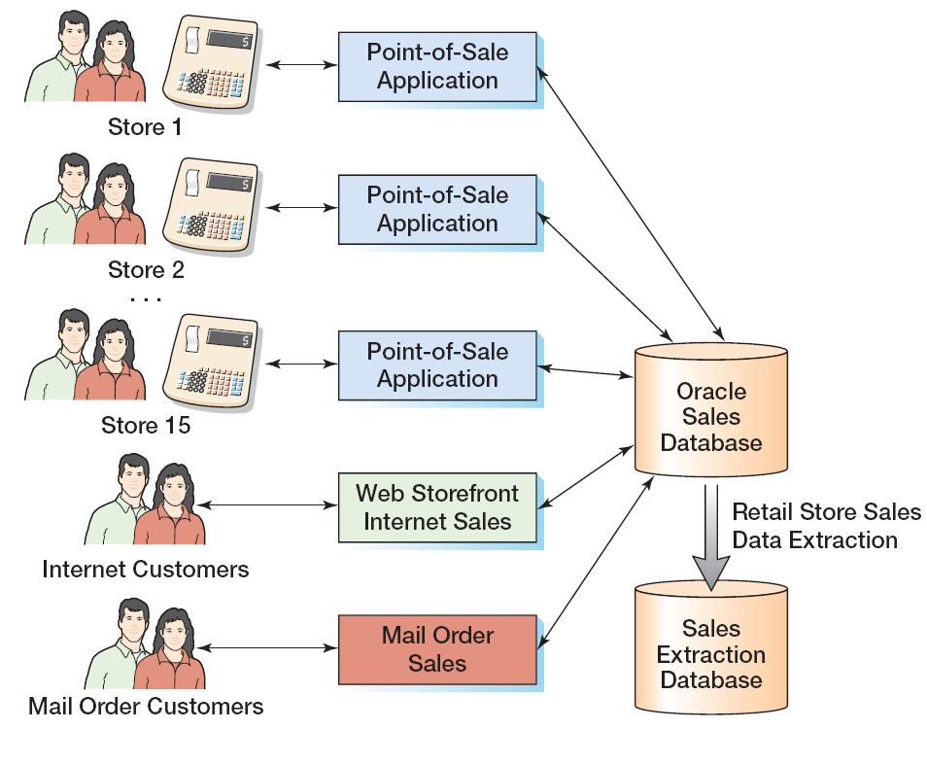
Cape Codd Retail Sales Structure

Slide 8
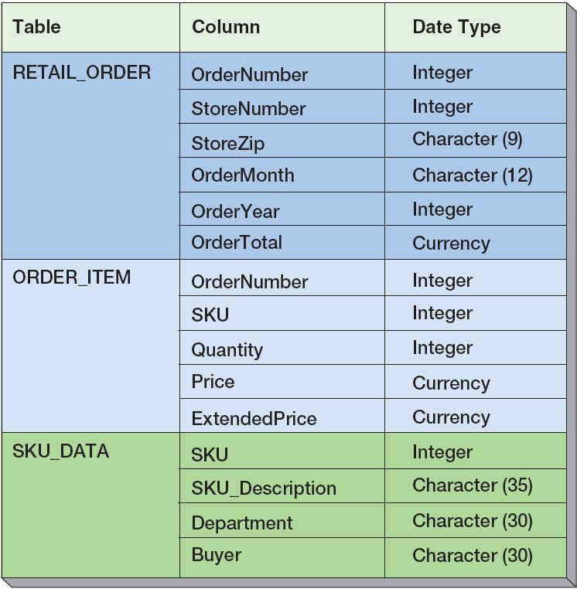
Extracted Retail Sales Data Format
See page 63

Slide 9
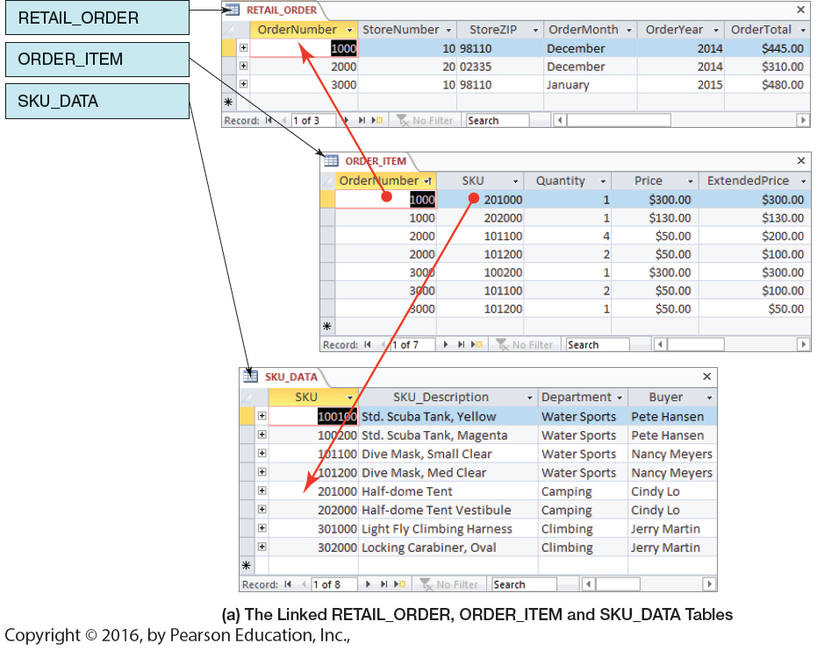
Retail Sales Extract Tables
See page 69

Slide 10
The SQL SELECT Statement
The fundamental framework for SQL query states is the SQL SELECT statement
  SELECT {ColumnName(s)}
  FROM {TableName(s)}
  WHERE {Conditions} ;
All SQL statements end with a semi-colon (;)

Slide 11
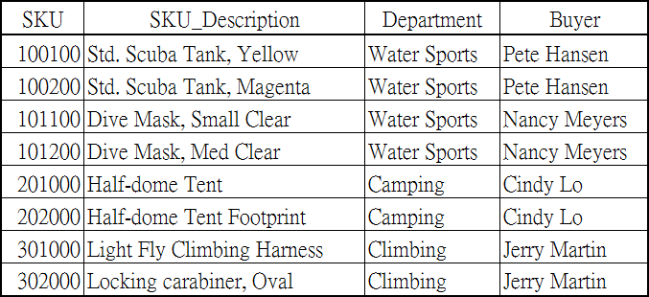
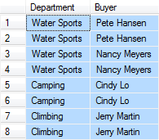
Specific Columns on One Table
SELECT Department, Buyer
FROM SKU_DATA;

Slide 12
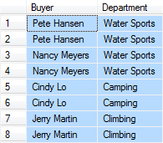
Specifying Column Order
SELECT Buyer, Department
FROM SKU_DATA;

Slide 13

The DISTINCT Keyword
SELECT DISTINCT Buyer, Department
FROM SKU_DATA;

Slide 14
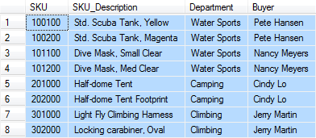
Selecting All Columns:
The Asterisk (*) Keyword
SELECT *
FROM SKU_DATA;

Slide 15

Specific Rows from One Table
SELECT *
FROM SKU_DATA
WHERE Department = 'Water Sports';

Slide 16

Specific Columns and Rows from One Table
SELECT SKU_Description, Buyer
FROM SKU_DATA
WHERE Department = 'Climbing';

Slide 17
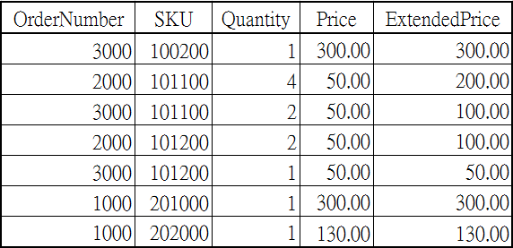
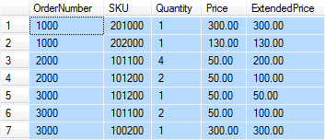
Sorting the Results—ORDER BY
SELECT *
FROM ORDER_ITEM
ORDER BY OrderNumber, Price;

Slide 18
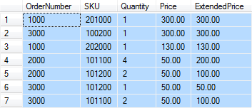
Sort Order:
Ascending and Descending
SELECT *
FROM ORDER_ITEM
ORDER BY Price DESC, OrderNumber ASC;

Slide 19

WHERE Clause Options—AND
SELECT *
FROM SKU_DATA
WHERE Department = 'Water Sports'
AND Buyer = 'Nancy Meyers';

Slide 20

WHERE Clause Options— OR
SELECT *
FROM SKU_DATA
WHERE Department = 'Camping'
OR Department = 'Climbing';

Slide 21
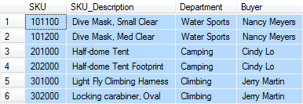
WHERE Clause Options— IN
SELECT *
FROM SKU_DATA
WHERE Buyer IN ('Nancy Meyers',
'Cindy Lo', 'Jerry Martin');

Slide 22

WHERE Clause Options—NOT IN
SELECT *
FROM SKU_DATA
WHERE Buyer NOT IN ('Nancy Meyers',
'Cindy Lo', 'Jerry Martin');

Slide 23

WHERE Clause Options—Ranges with BETWEEN
SELECT *
FROM ORDER_ITEM
WHERE ExtendedPrice
BETWEEN 100 AND 200;

Slide 24
WHERE Clause Options—Ranges with Math Symbols
SELECT *
FROM ORDER_ITEM
WHERE ExtendedPrice >= 100
AND ExtendedPrice <= 200;

Slide 25
WHERE Clause Options—
LIKE and Wildcards
The SQL keyword LIKE can be combined with wildcard symbols:
  _ = exactly one character
  % = any set of one or more characters

Slide 26
WHERE Clause Options—
LIKE and Wildcards
SELECT *
FROM SKU_DATA
WHERE Buyer LIKE 'Pete%';

Slide 27

WHERE Clause Options—
LIKE and Wildcards
SELECT *
FROM SKU_DATA
WHERE SKU_Description LIKE '%Tent%';

Slide 28

WHERE Clause Options—
LIKE and Wildcards
SELECT *
FROM SKU_DATA
WHERE SKU LIKE '%2__';

Slide 29
本週作業
Page 124 ~ Page 128 (2.33 以前)

